Slide 1
Porting 8.1 Apps to Windows 10
A Developer's Guide to Windows 10 Andy & Jerry

Slide 2
Agenda
Migration Paths to Windows 10
Windows 8.0/8.1 Store Apps
Windows Phone 8.1 Store Apps (WinRT)
Windows 8.1 Universal Apps
Windows Phone Silverlight Apps
Migrating a Windows 8.1/Windows Phone 8.1 Project
Upgrade Utility
Additional Migration Steps
Migrating 8.1 Universal Apps
Migrating Universal Apps
Handling the Shared Project

Slide 3
Extend your app to multiple device families and use new capabilities by targeting the UWP

Slide 4
Migration Paths to Windows 10

Slide 5
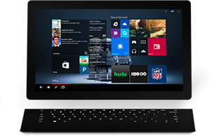
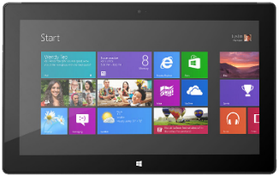

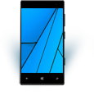
Windows 8.0/8.1 Store Apps
Minimal code update required
Responsive UX Design/Implementation
Windows 8.0
Windows 10

Slide 6
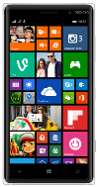
Windows Phone 8.1 Store Apps (WinRT)
Windows Phone 8.1
Windows 10
Minor code updates for UAP APIs
Design UX for multiple form factors

Slide 7
Windows 8.1 Universal Apps
Merge UX
Refactor to single code-base & to target UAP APIs
Windows 8.1
Windows 10
Windows Phone 8.1

Slide 8
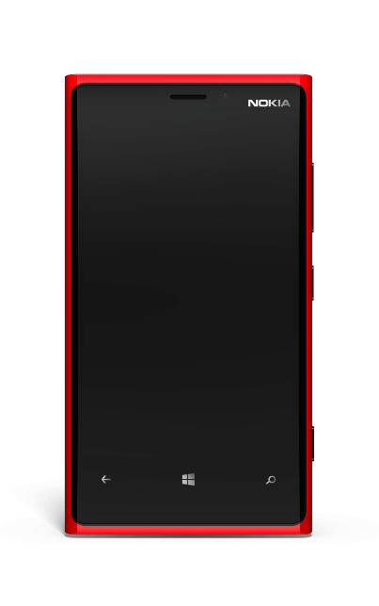

Windows Phone Silverlight Apps
Port the UI Silverlight -> Windows XAML
Rewrite code to target UAP APIs*
Design UX for multiple form factors
Windows Phone 7.5/7.8
Windows 10
Windows Phone 8.0
Windows Phone 8.1*
*Silverlight on Windows Phone 8.1 can be a mix of Silverlight and WinRT APIs

Slide 9
Porting – What You Can Expect
8.1 WinRT app code needs few changes
App lifecycle, background execution, Tiles and toasts – all the same
UAP APIs are a superset of the Windows 8.1 WinRT APIs
Review/change logic that relied on compiler conditionals (#if…) to handle platform differences
A few APIs are deprecated (example, Phone 8.1 …AndContinue APIs)
Charms bar gone so app must now display UI to launch Settings, Share or Search
8.1 WinRT XAML UI ports across fairly easily
Though you have work to do if you want to build adaptive UI working across multiple device families
Care needed with deprecated and altered styles and with font size changes
Silverlight 7.x/8.x apps need reimplementation
Though these apps still run on Windows 10 Mobile devices!
Porting tool is coming… (as at May 2015)
Notes:
“If you are currently a Windows Phone Silverlight developer, there’s never been a better time to investigate moving your development over to Windows XAML, which provides the ability to deliver universal Windows apps.”

Slide 10
Porting a Windows 8.1 or Windows Phone 8.1 Project

Slide 11
Porting an 8.1 WinRT Project
Project file and package.appxmanifest need modifications
No upgrade script in the //BUILD/ release of the tools
…but we’ve written a Powershell script to do most of the work ☺
Get it at http://aka.ms/uwp-projectupgradeutility

Slide 12
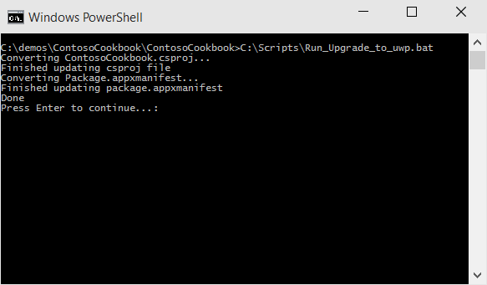
Upgrade_to_uwp Powershell script
Automates most of the upgrade steps – doesn’t do everything!
Converts .csproj to UWP, updates package.appxmanifest
Run directly in Powershell (needs script execute allowed), or run Run_Upgrade_to_UWP.bat at cmd prompt

Slide 13
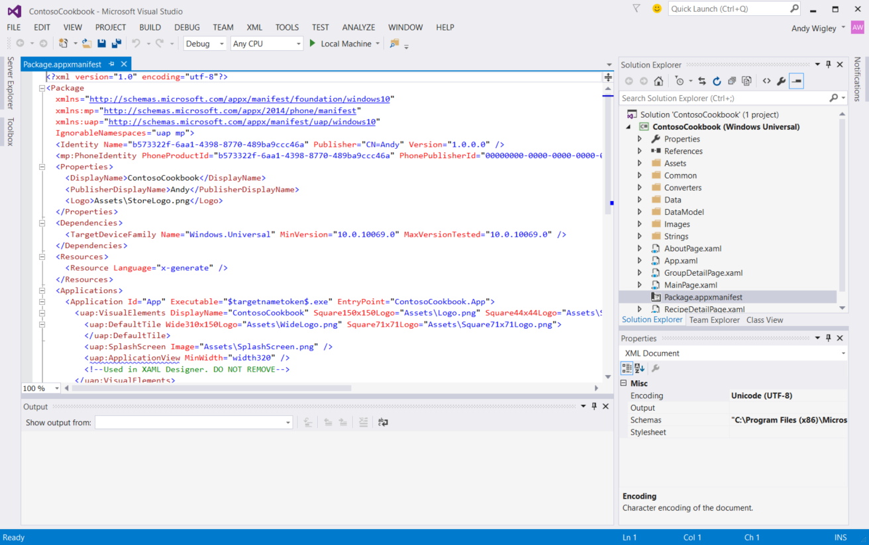
Updated Project

Slide 14
Manual project file updates
Add Publisher to PackageDependency:
Change to:
<Dependencies>
<PackageDependency Name="Microsoft.VCLibs.120.00.Phone" MinVersion="12.0.30113.0" />
</Dependencies>
<Dependencies>
. . .
<PackageDependency Name="Microsoft.VCLibs.120.00.Phone" MinVersion="12.0.30113.0"
Publisher="CN=Microsoft Corporation, O=Microsoft Corporation, L=Redmond, S=Washington, C=US" />
</Dependencies>

Slide 15
Manual package.appxmanifest edits
Add uap: prefix to some extensions:
<Application>
<Extension Category="windows.protocol">
<Protocol Name="mailto" DesiredView="useHalf">
<DisplayName>MailTo Protocol</DisplayName>
</Protocol>
</Extension>
</Application>
<Application>
<uap:Extension Category="windows.protocol">
<uap:Protocol Name="mailto" DesiredView="useHalf">
<uap:DisplayName>MailTo Protocol</uap:DisplayName>
</uap:Protocol>
</uap:Extension>
</Application>

Slide 16
Manual package.appxmanifest edits
If upgrading Windows 8.1 app, change tile size:
Change to:
<m2:VisualElements DisplayName="WWA_URI_StartPage" Square150x150Logo="Assets\Logo.png"
Square30x30Logo="Assets\SmallLogo.png"
Description="WWA_URI_StartPage" ForegroundText="light" BackgroundColor="#464646">
<m2:DefaultTile ShortName="McaApp" Wide310x150Logo="images/310x150.png"
Square310x310Logo="images/310x310.png"
Square70x70Logo="images/71x71.png" DefaultSize="square150x150Logo">
<m2:SplashScreen Image="Assets\SplashScreen.png" />
</m2:VisualElements>
<uap:VisualElements DisplayName="WWA_URI_StartPage" Square150x150Logo="Assets\Logo.png"
Square44x44Logo="Assets\SmallLogo.png"
Description="WWA_URI_StartPage" ForegroundText="light" BackgroundColor="#464646">
<uap:DefaultTile ShortName="McaApp" Wide310x150Logo="images/310x150.png"
Square310x310Logo="images/310x310.png"
Square71x71Logo="images/71x71.png" DefaultSize="square150x150Logo">
<uap:SplashScreen Image="Assets\SplashScreen.png" />
</uap:VisualElements>

Slide 17
Deprecated Elements
<m2:VisualElements
DisplayName="My Awesome App"
Square150x150Logo="Assets\Logo.png"
Square30x30Logo="Assets\SmallLogo.png"
Description="My Awesome App“
BackgroundColor="#464646"
ForegroundText="light“
ToastCapable=“True”>
<m2:SplashScreen Image="Assets\SplashScreen.png" />
<m2:DefaultTile
ShortName=“MyApp”
Wide310x150Logo=“310x150.png”
Square310x310Logo=“310x310.png”
Square70x70Logo=“70x70.png”
DefaultSize=“square150x150Logo”/>
<m2:ApplicationView MinWidth=“width320”/>
</m2:VisualElements>
<uap:VisualElements
DisplayName="My Amazing App"
Square150x150Logo="Assets\Logo.png"
Square44x44Logo="Assets\SmallLogo.png"
Description="My Amazing App"
BackgroundColor="#464646">
<uap:SplashScreen
Image="Assets\SplashScreen.png" />
<uap:DefaultTile
ShortName=“MyApp”
Wide310x150Logo=“310x150.png”
Square310x310Logo=“310x310.png”
Square71x71Logo=“70x70.png”/>
</uap:VisualElements>

Slide 18
Window Sizes (launch and min size)
Application View Class
PreferredLaunchWindowingMode
Modes: Auto, PreferredLaunchViewSize & FullScreen
PreferLaunchViewSize
SetPreferredMinSize
Default min size: 500x320px
Largest min size: 500x500px
Example
ApplicationView.GetForCurrentView().SetPreferredMinSize(
new Size { Width = 320, Height = 320 });

Slide 19
See MSDN documentation for manifest changes: What's different in Windows 10 Insider Preview https://msdn.microsoft.com/library/windows/apps/dn965501.aspx

Slide 20
Porting an 8.1 XAML app
http://aka.ms/W10P-HOL03

Slide 21
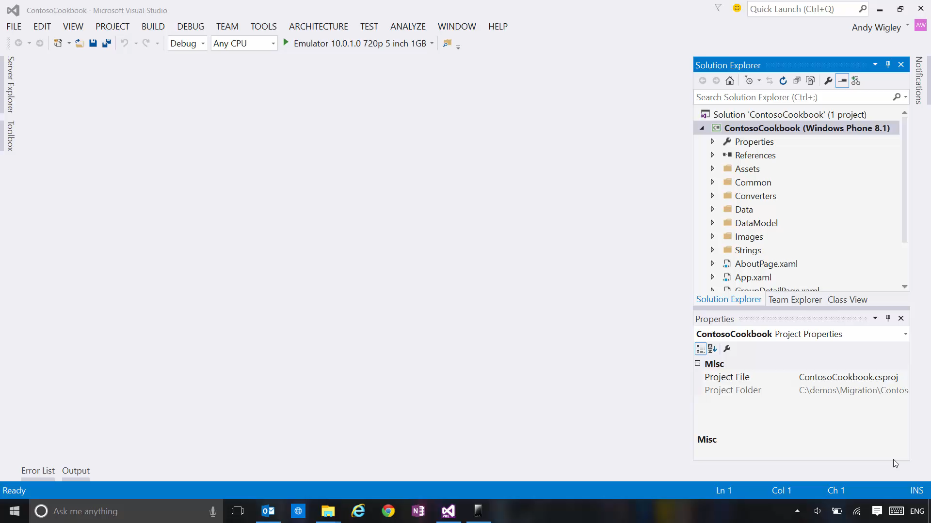

Slide 22
Additional Conversion Steps
Review conditional code (#if…) and convert to adaptive code where appropriate
Add Reference to Platform Extension SDKs, if needed
Replace calls to deprecated APIs, if any
Replace undefined and review retained styles in XAML
Update code that integrates with Charms bar
Extend your UI to create a great, adaptive UI that works across multiple device families!

Slide 23
1. Review #if conditional compilation
Compiler conditionals may be used in shared code:
this.Page.Loaded += (sender, e) =>
{
#if WINDOWS_PHONE_APP
Windows.Phone.UI.Input.HardwareButtons.BackPressed += HardwareButtons_BackPressed;
#else
// Keyboard and mouse navigation only apply when occupying the entire window
if (this.Page.ActualHeight == Window.Current.Bounds.Height &&
this.Page.ActualWidth == Window.Current.Bounds.Width)
{
// Listen to the window directly so focus isn't required
Window.Current.CoreWindow.Dispatcher.AcceleratorKeyActivated +=
CoreDispatcher_AcceleratorKeyActivated;
Window.Current.CoreWindow.PointerPressed +=
this.CoreWindow_PointerPressed;
}
#endif
};

Slide 24
Handling Back Button
Desktop: Enable Chrome back button (coming soon)
Single converged back button API
Example:
protected override void OnNavigatedTo(NavigationEventArgs e)
{
var frame = Window.Current.Content as Frame;
if (frame.CanGoBack)
{
SystemNavigationManager.GetForCurrentView().AppViewBackButtonVisibility = AppViewBackButtonVisibility.Visible;
}
else
{
SystemNavigationManager.GetForCurrentView().AppViewBackButtonVisibility = AppViewBackButtonVisibility.Collapsed;
}
SystemNavigationManager.GetForCurrentView().BackRequested += Page_BackRequested;
}

Slide 25
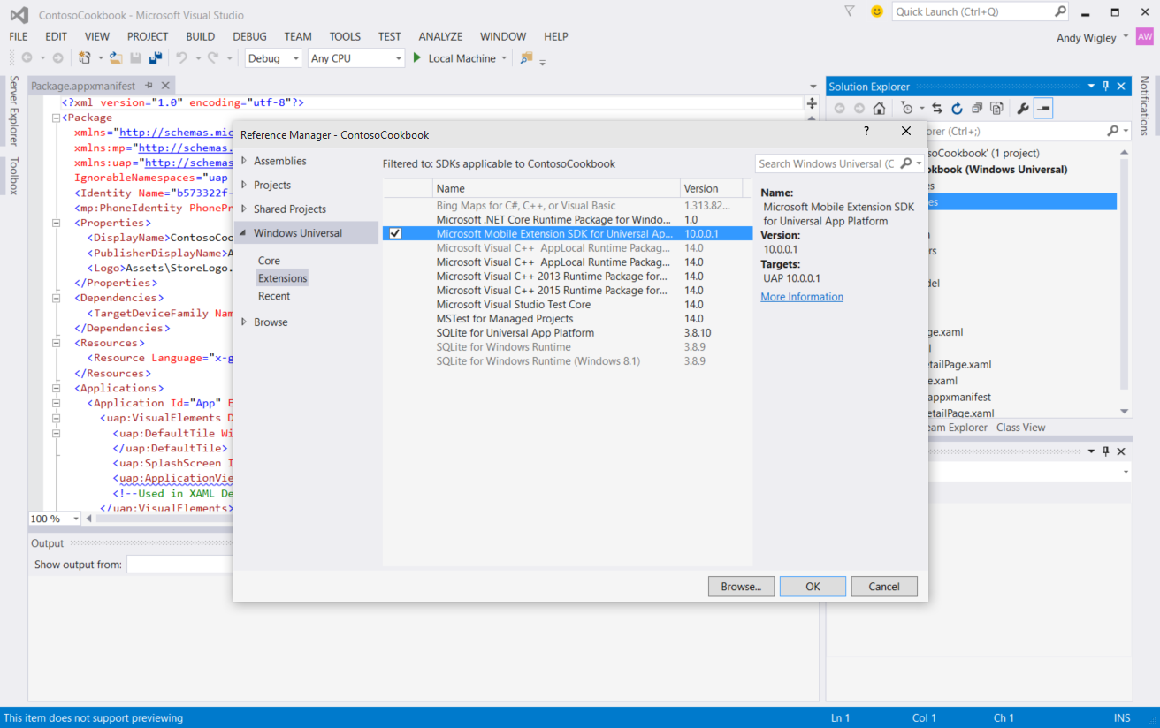
2. Add Ref for Platform extensions

Slide 26
Adaptive code
var api = "Windows.Phone.UI.Input.HardwareButtons";
if (Windows.Foundation.Metadata.ApiInformation.IsTypePresent(api))
{
Windows.Phone.UI.Input.HardwareButtons.CameraPressed += CameraButtonPressed;
}

Slide 27
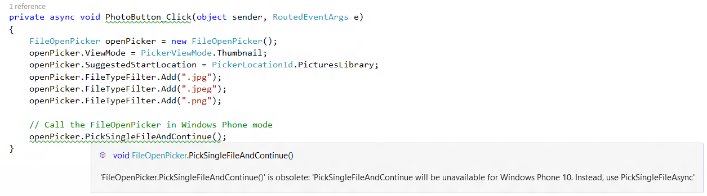
3. Replace Deprecated APIs

Slide 28
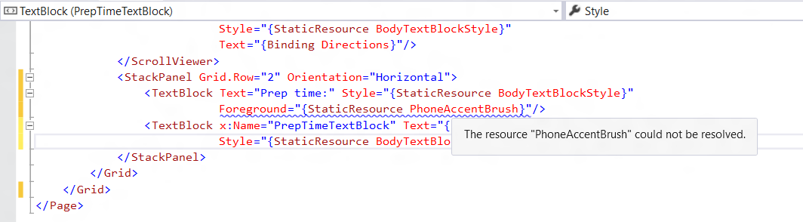
4. Review all use of Styles and Sizes
Replace undefined Styles in XAML with alternatives:

Slide 29
New scale factors
Scale Factors | 100 | 125 | 150 | 200 | 250 | 300 | 400
Single scale factor system for all apps
Great alignment with other app platforms
Guarantees consistent visual size of text and graphics (abstracts panel density and viewing distance for you)
100%, 200% and 400% are the most important sizes to support in assets
Scale factors work well with 4-px grid

Slide 30
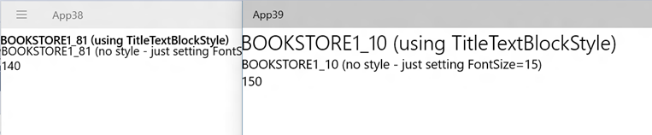
Scaling gotcha’s
Old scale factors may be larger now
140% -> 150% , 180% - > 200%?
Visual refresh has changed font sizes
Ex: TitleTextBlockStyle
(8.1) FontSize=14.667 (10.0) FontSize=24
Example (left 8.1 App, Right 10.0)

Slide 31
5. Update Charms Bar Integration Code
Charms bar not on Windows 10 devices
Replace with in-app UI for
Search
App Settings
Sharing
Underlying code does not change, just the users’ way of accessing them

Slide 32
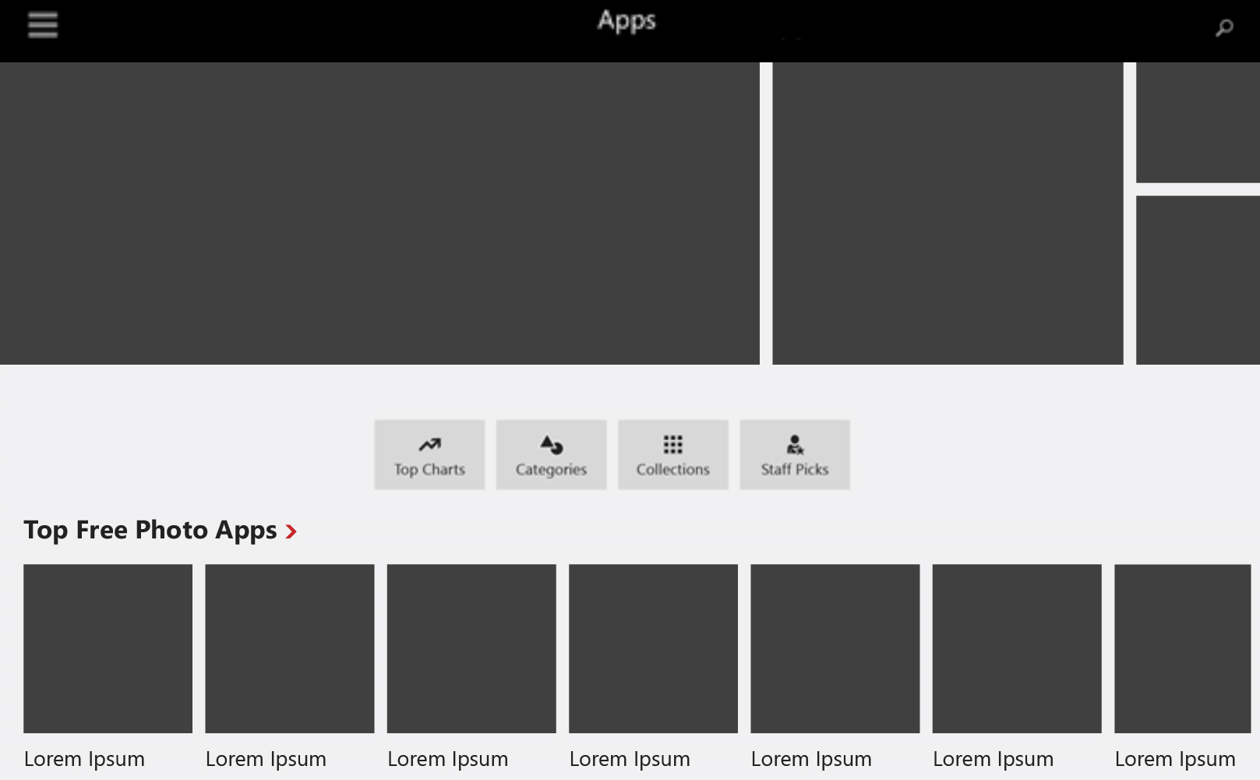
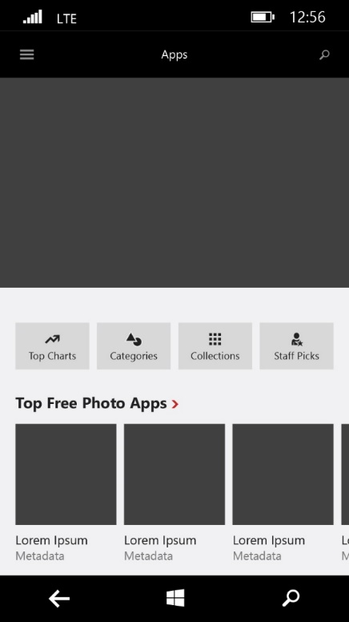
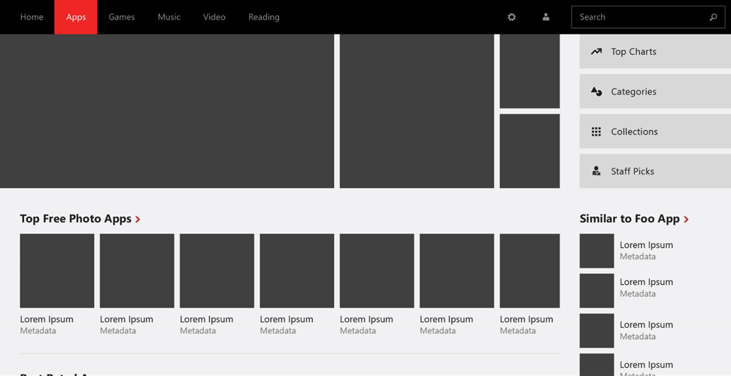
6. Create an awesome adaptive UI!
small landscape view
Phone/narrow view
large landscape view

Slide 33
Migrating 8.1 universal apps

Slide 34
What about 8.1 Universal apps?
Choose one head to port Phone or PC/Tablet
Merge UI from other head into adaptive UI Phone and PC/Tablet UI combined in the UAP project
Choose what to do with Shared Shared or merged

Slide 35
What to do with your Shared project?
If you keep a Shared project
WINDOWS_APP
WINDOWS_PHONE_APP
WINDOWS_UAP (new)
You will still need to test for API support
If you don’t keep a Shared project
You are only targeting Windows 10
Replace #if conditional compilation with adaptive code: Windows.Foundation.Metadata.ApiInformation

Slide 36
Review
Migration Paths to Windows 10
Windows 8.0/8.1 Store Apps
Windows Phone 8.1 Store Apps (WinRT)
Windows 8.1 Universal Apps
Windows Phone Silverlight Apps
Migrating a Windows 8.1/Windows Phone 8.1 Project
Upgrade Utility
Additional Migration Steps
Migrating 8.1 Universal Apps
Migrating Universal Apps
Handling the Shared Project

Slide 37
Further Information
//BUILD/ Session 3-741
Moving to the Universal Windows Platform: Porting an App from Windows 8.1 XAML or Windows Phone Silverlight to Windows 10
http://channel9.msdn.com/Events/Build/2015/3-741

